Slide 1
Working with interventions

Slide 2
Intervention
Technology introduced to interrupt established behaviour
Results in new behaviour
New behaviour may be good or bad (in either case will inform future designs)

Slide 3
New capabilities & features
Adding new value to existing technology
Adding technology to existing objects

Slide 4
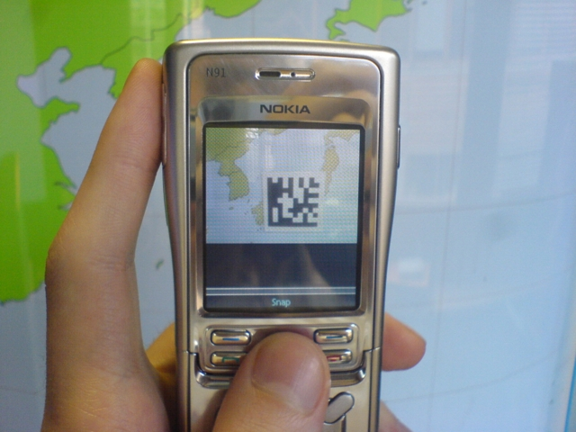

Slide 5
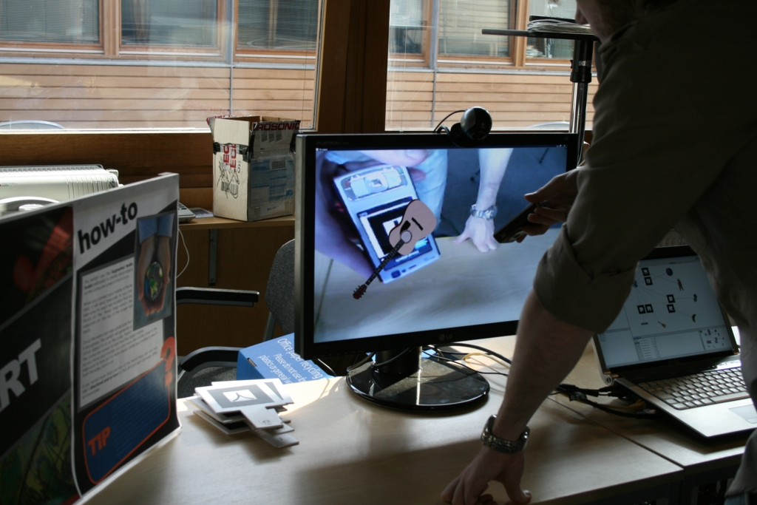

Slide 6
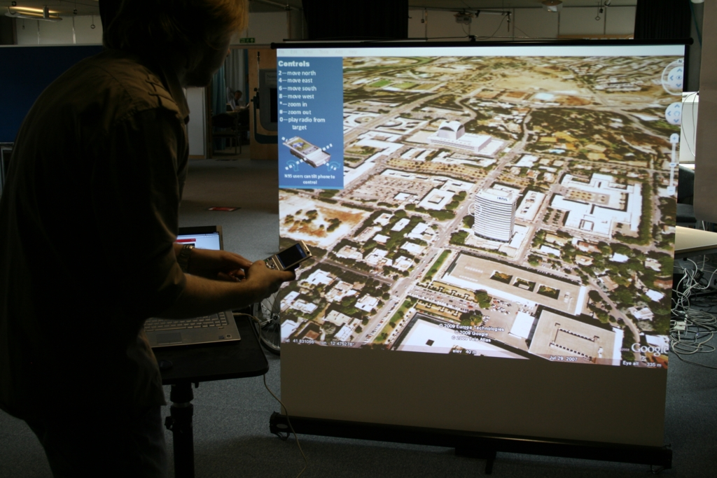

Slide 7
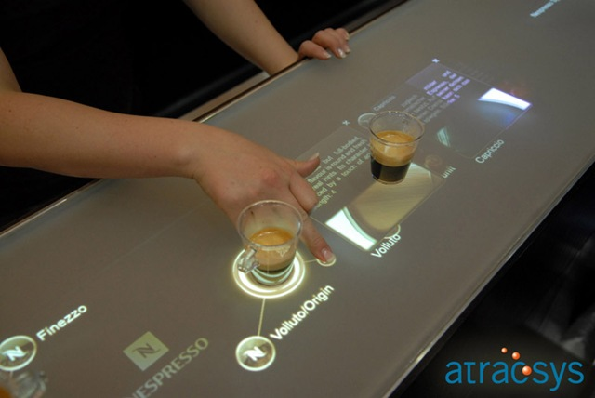

Slide 8
New places
Public vs. personal
Open vs. private

Slide 9
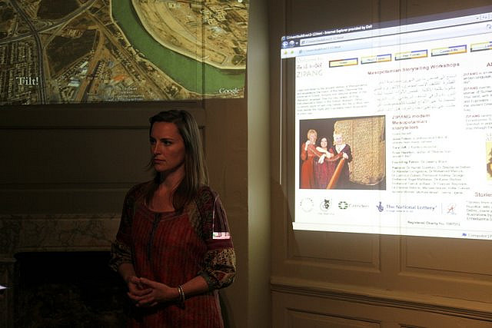

Slide 10
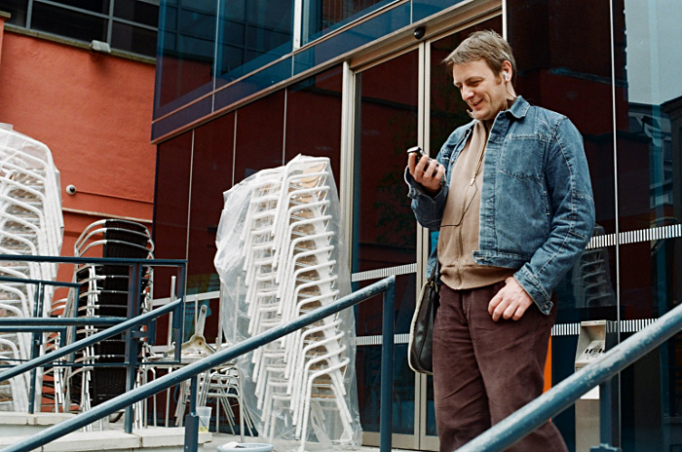

Slide 11
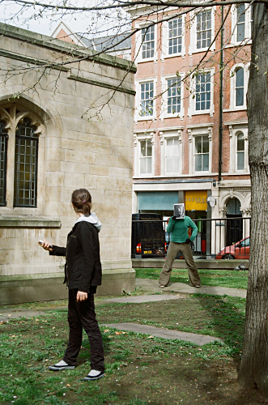

Slide 12
New combinations
Physical integration
Service integration
Data integration

Slide 13
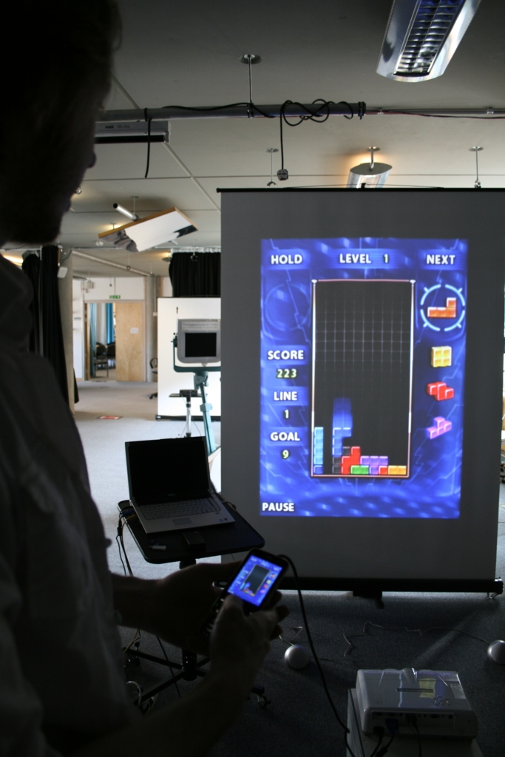

Slide 14
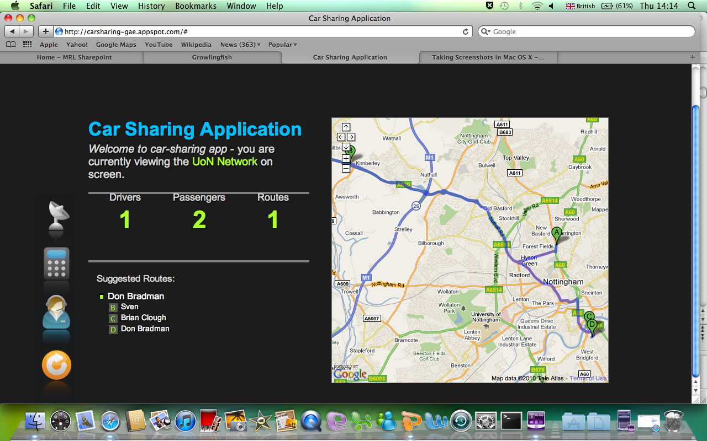
Application domain

Slide 15
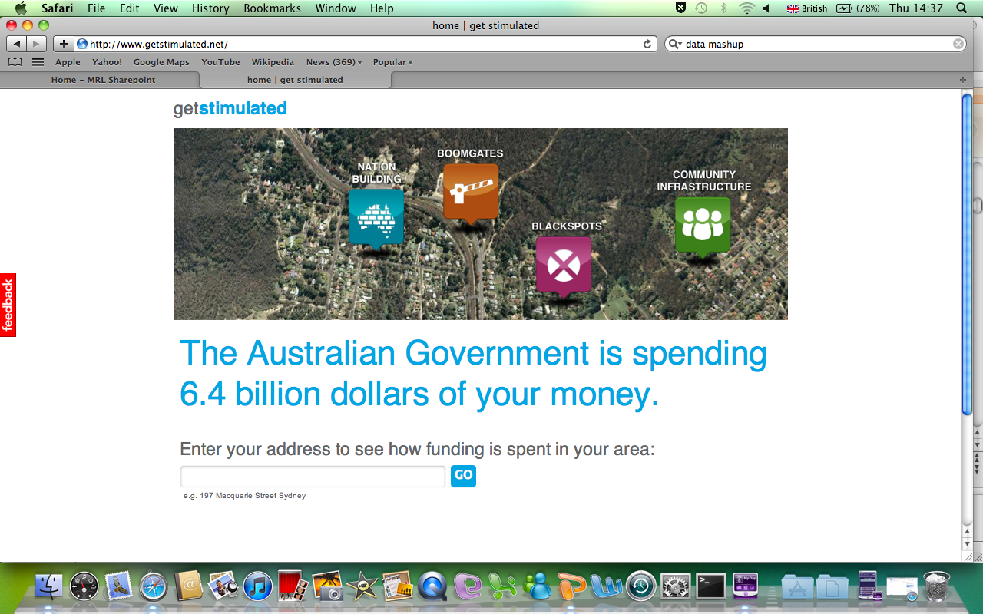

Slide 16
User-centred development through interventions

Slide 17
Development
Rapid prototyping
Simple prototypes
Not robust
Not fully-functional
Tested by potential end-users
Rapid integration of user feedback
Rich and qualitative

Slide 18
C-Aware application(s)

Slide 19
Application domain
Generation
Supply
Retail
Consumption

Slide 20
Application domain
Generation
Supply
Retail
Consumption

Slide 21
Application domain
Consumption
Travel
Workplace
Home

Slide 22
Applications
Cross-cultural workplace
Horizon vs. China Mobile research

Slide 23
Applications
Cross-cultural workplace
Horizon vs. China Mobile research
Cross-cultural student living
University of Nottingham UK vs. China student halls
Public/private transport
Smart logistics in Nottingham
Personal energy profile
Complete view of personal consumption footprint
Built environment auditing
Ningbo construction and maintenance data consortium

Slide 24
Cross-cultural workplace
Revealing emissions from workplace energy use

Slide 25
Key points
Infrastructure for monitoring and control (generic)
Using low-cost infrastructure (M2M?) for sensing/control
Maintaining system state in web-based data store (personal container?)
3 user interfaces (specific)
Using 3 types of device
For 3 types of end-user
Field trial work-plan

Slide 26
Monitoring

Slide 27
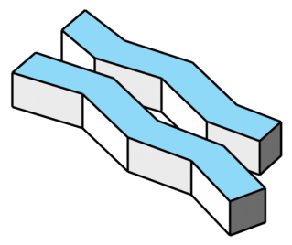
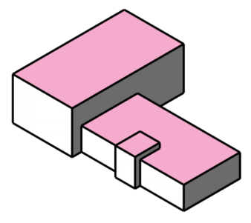
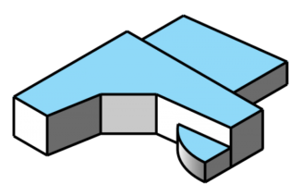

Slide 28
Architecture - monitoring

Slide 29

Architecture - monitoring

Slide 30
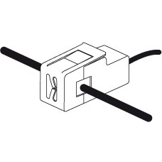

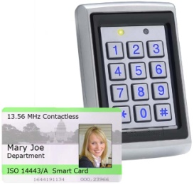
Architecture - monitoring
Service supplies, e.g. mains electricity monitors
Service use, e.g. individual electrical appliance monitors
Staff movement monitors

Slide 31
Architecture - monitoring
Service supplies, e.g. mains electricity monitors
Service use, e.g. individual electrical appliance monitors
We can consider a range of sources of emissions (different utilities, e.g. electricity, gas, water), and who/what is responsible for those emissions (e.g. number/type of staff, number/type of appliances, current processes)
Staff movement monitors

Slide 32
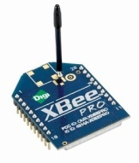
Architecture - monitoring
Each sensor Zigbee
enabled

Slide 33

Architecture - monitoring

Slide 34
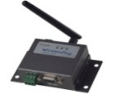
Architecture - monitoring
M2M module
Zigbee wireless data transfer

Slide 35
Architecture - monitoring
M2M module
Zigbee wireless data transfer
When does this occur?
Regularly (e.g. once per minute) and/or triggered by events (e.g. when door is opened)?

Slide 36
Architecture - monitoring
M2M module

Slide 37

Architecture - monitoring
Data store
The M2M module passes the data from the various sensors – via mobile phone network – to an online data store

Slide 38
Architecture - monitoring
Data Store
Company 1
Company 2
Owns
Owns
Owns
Workplace 1
Workplace 2
Workplace 1
Is located in
Employed by
Employed by
Appliance 1
Employee 2
Appliance 2
Operated by
Appliance 1

Slide 39
Architecture - monitoring
Data Store
Company 1
Company 2
Owns
Owns
Owns
Workplace 1
Workplace 2
Workplace 1
Is located in
Employed by
Employed by
Appliance 1
The data store requires a common (open?) schema to allow relationships to be expressed clearly and for entities to be compared. What is a reasonable schema for our trial?
Employee 2
Appliance 2
Operated by
Appliance 1

Slide 40
User Interfaces
Presentation and Control

Slide 41
Architecture - presentation
Data store
End-user Interfaces
User interfaces are driven by the data from the data store

Slide 42
Architecture - presentation
User Interfaces
Who are the potential end users?
Staff/tenants of a workplace
Managers of a workplace
Maintenance
Service suppliers (e.g. national grid)
Service retailers

Slide 43
Architecture - presentation
User Interfaces
Who are the potential end users?
Staff/tenants of a workplace
Managers of a workplace
Maintenance
Service suppliers (e.g. national grid)
Service retailers
These are considered in other Horizon projects (e.g. Desimax)

Slide 44
Architecture - presentation
User Interfaces
Who are the end users?
Staff/tenants of a workplace
Managers of a workplace
Maintenance
Service suppliers (e.g. national grid)
Service retailers
The field-trial in C-Aware focuses on these

Slide 45
Architecture - presentation
User Interfaces
Who are the end users?
Staff/tenants of a workplace
Managers of a workplace
Maintenance
There are 3 interesting interfaces that could be designed for these users, each with different characteristics

Slide 46
Architecture - presentation
User Interfaces
Who are the end users?
Staff/tenants of a workplace – UI 1: Public display
Managers of a workplace – UI2: Private desktop display
Maintenance – UI3: Personal mobile display
There are 3 interesting interfaces that could be designed for these users, each with different characteristics

Slide 47
Architecture - presentation
End-user Interfaces
User interfaces are accessed by displays with web access

Slide 48
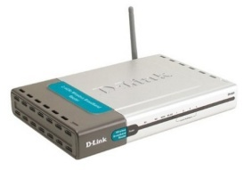
Architecture - presentation
Web access via workplace
UI1
Internal LAN
Web access via mobile network
UI2
UI3

Slide 49
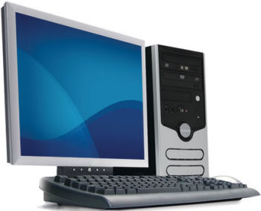
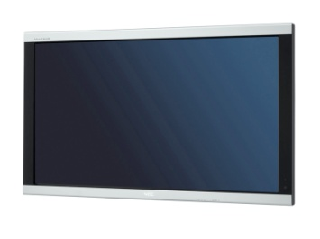
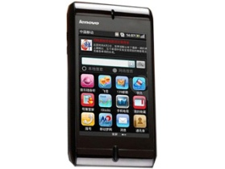
Architecture - presentation
UI1
UI2
UI3

Slide 50
User Interface 1
Public display for presenting data to employees

Slide 51
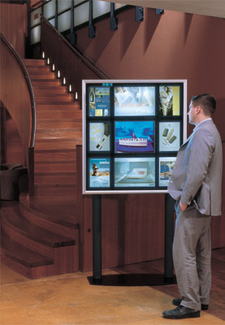
User interfaces
UI1: Public display for employees
Employees can be motivated to improve their working habits to reduce the emissions of the workplace
Each workplace will have a public display (or a number of identical displays?). The public display should show:
Progress of the workplace towards its goal(s)
The contribution of each team to the progress of the workplace
Comparison with progress of a competing workplace

Slide 52
User interfaces
UI1: Public display for employees
Employees can be motivated to improve their working habits to reduce the emissions of the workplace
Each workplace will have a public display (or a number of identical displays?). The public display should show:
Progress of the workplace towards its goal(s)
The contribution of each team to the progress of the workplace
Comparison with progress of a competing workplace
Similar workplaces will compete to reduce emissions; within a workplace, employees will be split into teams to compete to contribute the highest reductions
The display also conveys a positive image to visitors

Slide 53
User interfaces
Examples
Nottingham Teams
Nottingham in August
Week 1
Week 2
Week 3
Week 4

Slide 54
User interfaces
Examples
5.1% saving
7.1% saving

Slide 55
User interfaces
Examples
Week 4
University of Nottingham
So far: -3.2%
Goal: -5.0%

Slide 56











User interfaces
Examples
Horizon
Mixed Reality Lab
Saved £1900 this month
Saved £800 this month
No savings yet!
Saved £1200 this month
Business School
Library

Slide 57
User interfaces
Issues
Dynamic to maintain interest
UI1 must react to changes quickly, always reflecting new information in order to maintain the interest of the employees
Responsibility – reliably link action to emission to avoid incorrect public blame
Emission data must be reliably linked to the correct employees/teams within a workplace (we should not incorrectly ‘blame’ employees)
Teams, not individuals – avoid individual accountability and build team relationships
Encouraging team competition within a workplace rather than individual competition is usually more effective as this builds relationships between employees and encourages widespread change in habits, rather than individual changes in habits
Progress towards goals by teams should be displayed publicly, but contributions by individual employees should not be shown publicly, so that competition within teams/personal embarrassment does not occur
Clear goals set by management – collective, achievable goals
Within a workplace, teams should compete to contribute to collective goals, not just to beat each other
Goals should be set by the owners/management of a workplace, and advice should be given on methods for improvement
Goals should be set/adjusted regularly to maintain engagement of employees
Rewards – competition is a reward
Employees of the winning team should consider enjoyment of the competition as the reward
Rewards for reaching a collective goal may be given to all employees; providing additional rewards to the winning team may discourage competition or encourage over-competition

Slide 58
User Interface 2
Private desktop display for presenting data to managers of a workplace

Slide 59
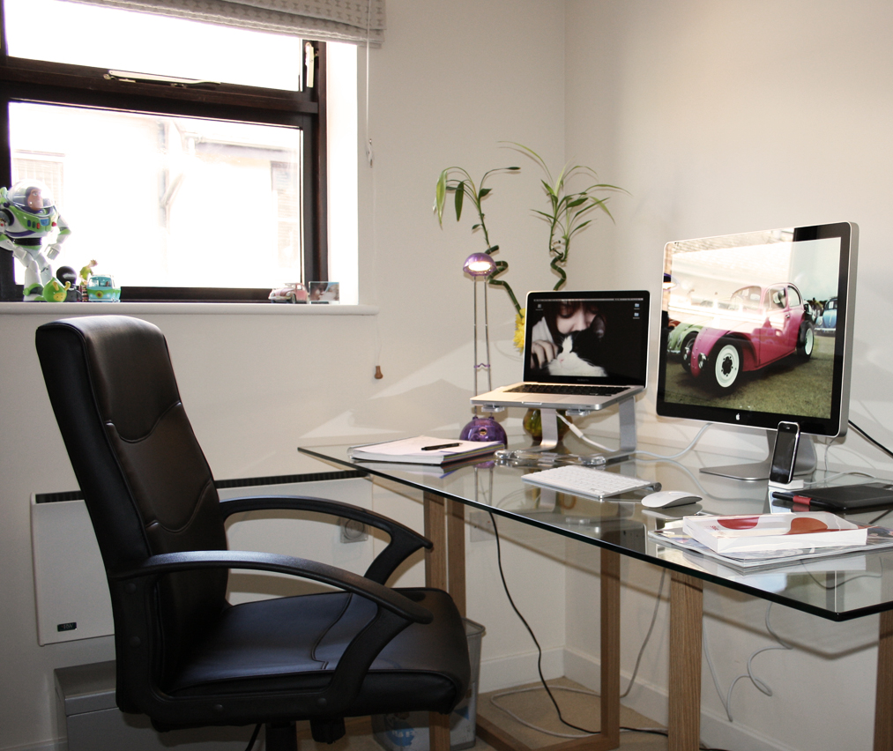
User interfaces
UI2: Private desktop display for managers of a workplace
Managers of the workplace can see which employees/appliances contribute to the emissions of the workplace, and monitor the effects of changes they make to the workplace
UI2 will allow managers to determine what behaviours are causing emissions (discover particular staff, appliances or processes that need to be changed)

Slide 60
User interfaces
UI2: Private desktop display for managers of a workplace
Managers of the workplace can see which employees/appliances contribute to the emissions of the workplace, and monitor the effects of changes they make to the workplace
UI2 will allow managers to determine what behaviours are causing emissions (discover particular staff, appliances or processes that need to be changed)
UI2 will also allow managers to assess the impact of any changes they make to staff/appliances (compare emissions before and after a change)

Slide 61
User interfaces
UI2: Private desktop display for managers of a workplace
Managers of the workplace can see which employees/appliances contribute to the emissions of the workplace, and monitor the effects of changes they make to the workplace
UI2 will allow managers to determine what behaviours are causing emissions (discover particular staff, appliances or processes that need to be changed)
UI2 will also allow managers to assess the impact of any changes they make to staff/appliances (compare emissions before and after a change)
UI2 should also allow managers to make comparisons between their workplace and other workplaces so that they can set goals

Slide 62
User interfaces
Examples
Staff
Appliances

Slide 63
User interfaces
Examples
Staff
Appliances

Slide 64
User interfaces
Examples
Staff
Appliances

Slide 65
User interfaces
Examples
Staff
Appliances
Current time
0.0% saving today

Slide 66
User interfaces
Examples
Staff
Appliances
10% saving this year
(£9000)

Slide 67
User interfaces
Examples
Similar workplaces in Nottingham
Company Z
Highest energy saving:
Computers (£9000)
University of Nottingham
-5.7%
+1.2%
+1.9%
-6.2% so far this month
Company Y
Highest energy saving:
Computers (£2200)
Company X
Highest energy saving:
Air conditioning (£5000)
1st

Slide 68
User interfaces
Examples
Progress for August
Total saving 5.0%
So far: 6.2%
Current saving
£11000
Best progress

Slide 69
User interfaces
Examples
Goal for September
Total saving 7.0%
Potential saving
£15000
Key targets
Reduced operating hours
Potential saving: £300
Reduced operating hours
Potential saving: £10000

Slide 70
User interfaces
Issues
Cost vs. emissions – policy makers motivated by cost
Managers will probably be motivated by the costs of energy use rather than emissions of energy use, therefore UI1 will need to emphasise the link between energy use and both costs and emissions
Responsibility – reliable reporting if UI makes individuals accountable
As with UI1, this interface would require emission data to be reliably linked to the correct employees/appliances within a workplace, particularly if managers are going to make changes based on data presented by the interface; the interface should not suggest a change unless it is highly likely to make a positive impact
Levels of information & privacy – reflect responsibility of individual managers
To preserve privacy UI1 only revealed team data; UI2 should allow data to be viewed at different levels of detail, allowing the manager to view the emissions of the entire workplace (and compare to other workplaces), emissions of teams (and compare to other teams), and emissions of individual employees and appliances
The amount of information should correspond to the information already available to a particular manager, e.g. if a manager only has responsibility for one team then they should not be able to view information about employees in other teams. For this reason, the interface must be restricted such that only specific managers can view it (by personal authentication)
Information about other workplaces must be anonymised so that a manager cannot find out about the structure/processes of a competing workplace
Goal setting – link to the public display
UI2 should allow the managers to set the goals that are shown in UI1; UI2 must allow the manager to assess the changes in emissions caused by setting goals – this will allow a manager to determine which changes to make permanent (enforcing changes made by a good team across the whole workplace), and which changes to reverse

Slide 71
User Interface 3
Personal mobile display for presenting data to maintenance staff and providing control

Slide 72
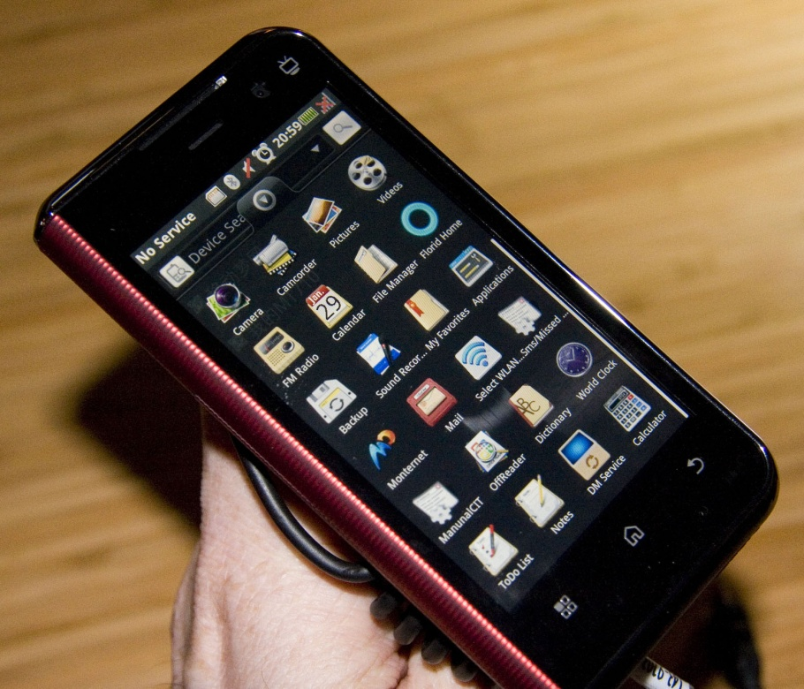
User interfaces
UI3: Personal mobile display for maintenance
UI3 will allow the user to compare the current status of appliances in the workplace to the “expected” status of the appliances, to determine whether an appliance is potentially faulty/requires maintenance
The mobile UI can be accessed inside or outside the workplace
The UI will allow an external maintenance company to monitor many workplaces simultaneously, comparing the effectiveness of appliances in different environments (giving evidence for recommendations to be made to managers for changes to workplaces)

Slide 73
User interfaces
University of Nottingham
Examples
Lights
00:00
21:47
17:00
07:00
Currently: switched off
Back

Slide 74
User interfaces
University of Nottingham
Examples
Lights
00:00
21:47
17:00
07:00
Currently: switched off
Back

Slide 75
User interfaces
University of Nottingham
Examples
Lights
00:00
21:47
19:00
07:00
Currently: switched off
Back

Slide 76
User interfaces
University of Nottingham
Examples
Lights
00:00
21:47
19:00
07:00
Currently: switched off
Back

Slide 77
User interfaces
Examples
All clients
University of Nott …
City Hospital
National College …

Slide 78
User interfaces
Examples
University of Nott …
Alert
City Hospital
Air conditioning in Business School has been operating for longer than expected
View
National College …

Slide 79
User interfaces
Examples
Air Conditioning: Univ…
Business School
Horizon
Library

Slide 80
User interfaces
Examples
Air Conditioning: Univ…
Business School
Horizon
Library

Slide 81
User interfaces
Examples
Air Conditioning: Univ…
Business School
Air Conditioning
Horizon
City Hospital
Internal temp.: 21°C
External temp.: 29°C
Employees in workplace: 0
Cancel
Switch off
Remind
Library
National College …

Slide 82
User interfaces
Issues
Authentication – security back-door
If UI3 can be used to control appliances remotely, we must ensure that only authorised personnel can use the interface
Accountability – responsibility for remote changes must be clear
If decisions to visit a workplace for maintenance are based on data provided by the interface, this data must be accurate
The effects of controlling appliances via the interface must be made clear to the user, so that the user does not negatively affect the workplace
A history of interactions with the workplace through UI3 must be kept so that the managers of the workplace can see what maintenance has been carried out

Slide 83
User Interface 3: control

Slide 84
Architecture - control
Web access via mobile network
UI3 allows user to request changes to workplace, e.g. switching air conditioning off
UI3

Slide 85
Architecture - control
Data store
UI3
Requests require changes to be made to data store

Slide 86
Architecture - control
Data Store
Company 1
Company 2
Owns
Owns
Owns
Workplace 1
Workplace 2
Workplace 1
Is located in
Employed by
Employed by
Entries in the data store for appliances will contain settings for operation (e.g. time to switch on/off) as well as emissions data; UI3 will modify the settings
Appliance 1
Settings
Emission data
Employee 2
Appliance 2
Operated by
Appliance 1

Slide 87
Architecture - control
Data store
The M2M module requests changes to appliance settings

Slide 88
Architecture - control
The M2M module passes settings changes back to the appropriate appliance
Are there any M2M sensors that can control appliances as well as monitor them? Can M2M modules send data back to M2M sensors as well as receiving data?

Slide 89
Field trial plan

Slide 90
Work plan
Phase 1 – Testing monitoring architecture
Review of existing monitoring infrastructures
Consultation with University of Nottingham ETC (http://www.nottingham.ac.uk/etc/) and Estates (http://www.nottingham.ac.uk/estate/) regarding current monitoring capabilities of University of Nottingham and local workplaces
Acquiring suitable sensors and sensor hub (e.g. M2M module) – check compatibility/portability with China
Deploying and testing sensor infrastructure in test site (Horizon Research)
Currently ongoing

Slide 91
Work plan
Phase 2 – Testing data store for monitoring
Developing schema for data store
Deploying data store on suitable web platform
Linking sensor infrastructure to data store and testing scalability of data store for long-term monitoring
Currently ongoing

Slide 92
Work plan
Phase 3 – Prototype (monitoring) user interfaces
Review of existing user interfaces for Carbon emission awareness
Rapid iteration of prototypes based on paper prototyping and short test deployments at local sites (student halls of residence at University of Nottingham, Horizon Research)
Internationalise interfaces
Currently ongoing

Slide 93
Work plan
Phase 4 – Test control architecture
Acquire and integrate suitable control hardware with monitoring hardware
Modify data store to support control
Test control functionality (reliability and response speed)

Slide 94
Work plan
Phase 5 – Prototype enhanced UI3
Modify UI3 to enable control functionality
Rapid iteration of UI3 prototype in consultation with various potential end-users

Slide 95
Work plan
Phase 6 – Formal field trials
Determine observation/data capture method + sites
Installation of monitoring/control infrastructure + UI devices on sites
Pre-trial interviews/focus groups with users
Trial
Post-trial interviews/focus groups with users

Slide 96
Work plan
Phase 7 - Analysis
Data sessions/workshop with stakeholders
Dissemination of results
Plan for follow-on proposals

Slide 97
Work plan
Phase | Months
 | 1-3 | 4-6 | 7-9 | 10-12 | 13-15 | 16-18 | 19-21 | 22-24
1 |  | Impl. monitoring
2 |  | Impl. data store
3 |  |  | Prototype UIs
4 |  |  |  | Impl. control
5
6 |  |  |  |  |  | Field trial
7 |  |  |  |  |  |  | Analysis
Notes:
3 month app spec
1 month buy infrastructure
3 months get Irene’s data
4 months analyse Irene’s data
3 months spec the deployment in china/uk
6 Months personal container
3 months first paper prototypes

Slide 98
Test/trial sites
Interesting workplace comparisons
Similar workplaces in different organisations
China Mobile Innovation building vs. Horizon Research office
Are employees/managers motivated by this competition?
Do they understand the comparison?
Similar workplaces within the same organisation
University of Nottingham: Horizon Research office vs. Mixed Reality Lab office
Employees regularly visit the opposite workplace and socialise with employees from the opposite workplace – how does this affect the motivation?

